Slide 1


ARABIC SPELLING CORRECTION

Slide 2

BRIEF:
Arabic spelling errors are common in digital text due to the language's complex morphology, multiple character forms, and lack of diacritics. Traditional spell checkers often fail to handle these challenges, especially in informal or dialectal writing.
This project presents a deep learning-based approach for Arabic spelling correction using MARBERT, a transformer model pre-trained on massive Arabic data. By fine-tuning it on a custom dataset with a Masked Language Modeling (MLM) objective, we build a system that can intelligently detect and correct misspelled words in context — even when the correct spelling depends on surrounding words.

Slide 3

🛠 OUR PROCESS
Problem Definition
Identifying the challenges of Arabic spelling correction and the limitations of traditional methods.
Data Collection & Preprocessing
Collected Arabic text data (111K+ rows)
Normalized characters and removed non-Arabic content
Filtered and tokenized sentences for training
Model Fine-Tuning
Used the MARBERT model with Masked Language Modeling
Fine-tuned on 10,000 samples with controlled hyperparameters
Trained using Hugging Face Transformers and FP16 acceleration

Slide 4
🛠 OUR PROCESS
Spelling Correction Pipeline
Detected misspelled words based on vocabulary and probability thresholds
Masked and predicted words using the model’s output
Replaced misspelled words with context-aware suggestions
Evaluation & Error Analysis
Tested on real examples
Analyzed model limitations and performance behavior
GUI & CLI Development
Built a Tkinter-based user interface
Integrated model predictions with real-time feedback
Added command-line access and programmatic API

Slide 5

DATASET INFORMATION
Source: Arabic dataset used for classification (arabic_dataset_classifiction.csv)
Size: 111,728 rows of Arabic text
Preprocessing:
Normalized Arabic text (unified alef forms)
Removed non-Arabic characters
Kept only sentences with more than 5 words
Built vocabulary with frequency filtering (min frequency = 3)
Training sample: 10,000 examples (80% training, 20% testing)

Slide 6
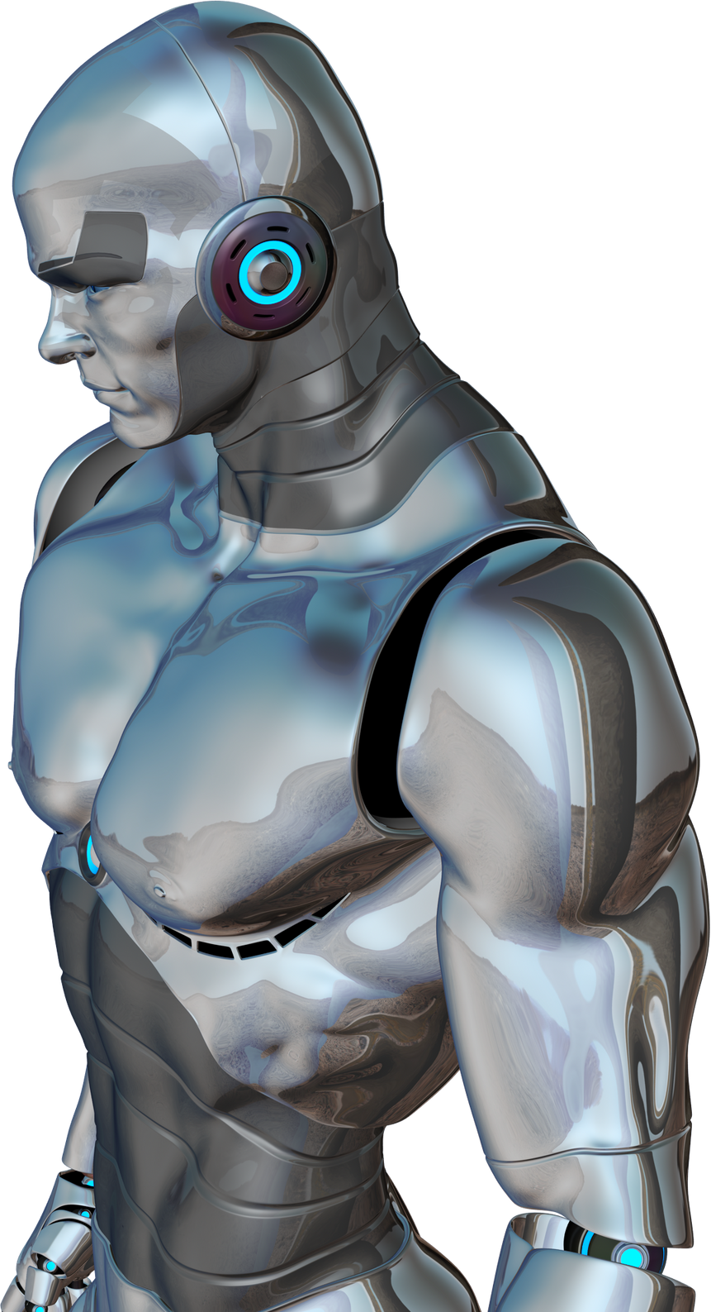
MODEL SELECTION
Base Model:
Selected UBC-NLP/MARBERT, a specialized Arabic BERT model
Pre-trained on a large corpus of Arabic text
Well-suited for Masked Language Modeling tasks
Model Configuration:
Used BertForMaskedLM architecture
Leveraged pre-trained weights for transfer learning

Slide 7

MODEL APPROACH
Masked Language Modeling: The model predicts masked words based on context
Spelling correction pipeline:
Preprocess input text (normalize characters)
Identify potential misspellings using:
Vocabulary check (words not in vocabulary)
Low probability threshold (< 0.15)
Create masked sentences for each misspelled word
Predict most likely word for each mask
Replace misspelled words with predictions

Slide 8
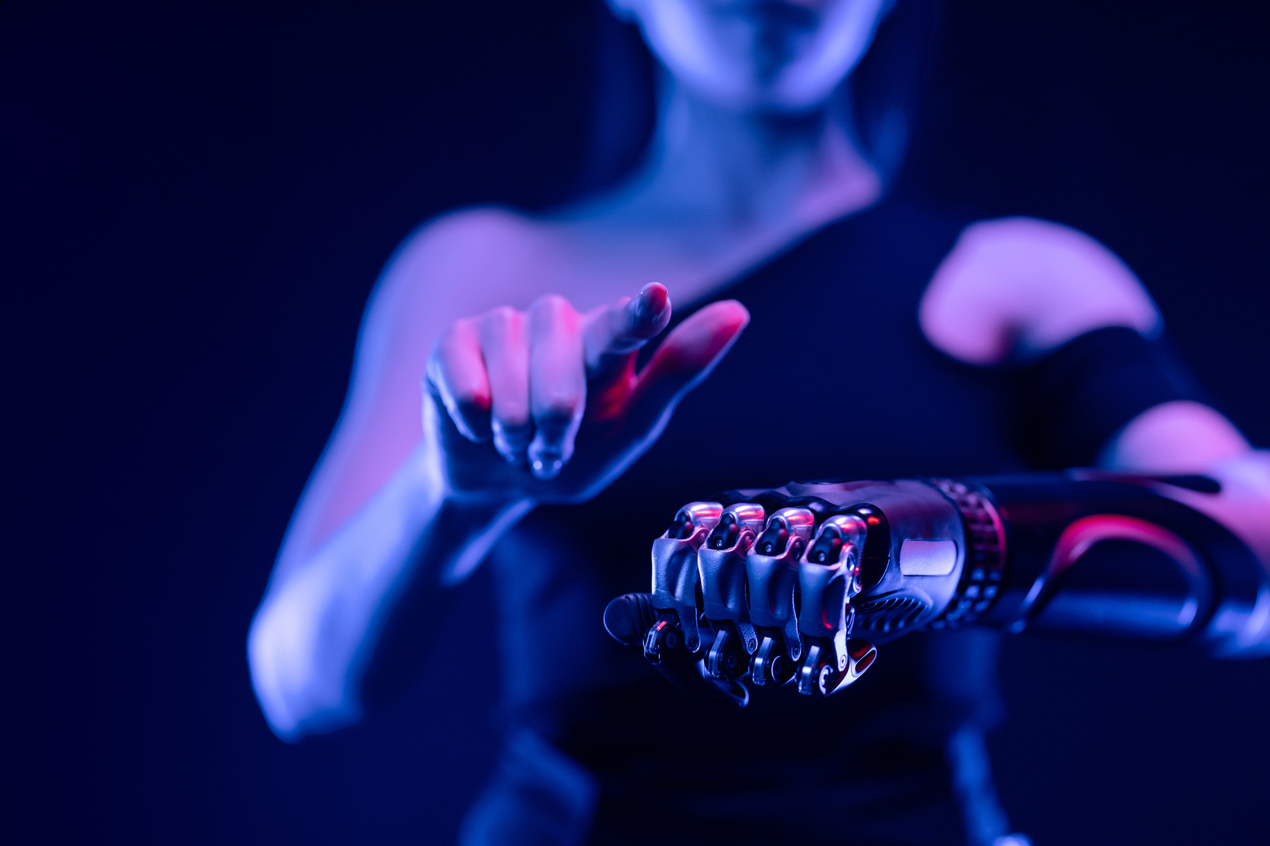
MODEL LIMITATIONS
Limited vocabulary size (based on 10,000 examples)
Can struggle with proper nouns or domain-specific terminology
Tendency to "over-correct" based on context rather than keeping unusual but correct words
May introduce semantic changes while fixing spelling
Performance depends on contextual information around misspelled words
Training Loss 2.532600
Validation Loss 2.733945

Slide 9
THANK YOU!
FOR YOUR ATTENTION

